Slide 1


Aditya Raj
06-03-2024

Slide 2

Outline
Executive Summary
Introduction
Methodology
Results
Conclusion
Appendix

Slide 3
Executive Summary
The project focuses on analyzing the SpaceX Falcon 9 data and building a prediction model to predict if a particular rocket launch will successfully land or not.
The entire presentation consists of the following sections:
Methodology
Insights from Exploratory Data Analysis
Launch Sites Proximities Analysis
Building a Dashboard with Plotly Dash
Predictive Analysis and Classification Model Building
The outcome of each step were analyzed and stored in separate Jupyter notebooks, images, and CSV files, wherever applicable. All the files have been shared in the GitHub repository.

Slide 4
Introduction
SpaceX is a leading private space agency that specializes in low-cost rocket launches. With its reusable first stage components of the Falcon 9 rockets, SpaceX is able to keep its operations costs almost one third of compared to other space agencies.
This project aims to analyze how successful is the Falcon 9 first stage landing. It also tries to predict whether a particular rocket launch will result in a successful landing of the first stage of the Falcon 9 rockets.
With different exploration tasks, the project also aims to analyze the effect of different factors such as launch site, payload mass, booster version, etc.

Slide 5

Section 1

Slide 6
Methodology
Executive Summary
Data collection methodology:
For the project, the data was collected using API calls to api.spacexdata.com using the requests module in Python. We also scraped data from Wikipedia page of Falcon 9 launches.
Perform data wrangling
To process data, we used the pandas module in Python for analysis and feature engineering.
Perform exploratory data analysis (EDA) using visualization and SQL
Perform interactive visual analytics using Folium and Plotly Dash
Perform predictive analysis using classification models
To build classification models, we used the scikit-learn module in Python.

Slide 7
Data Collection
The data was collected using two approaches.
The first approach uses the requests module in Python to fetch data from api.spacexdata.com.
The second approach uses the requests module and the BeautifulSoup module to fetch data from “List of Falcon 9 and Falcon Heavy launches” Wikipedia page.
The data collection process has been presented in the next slides.

Slide 8
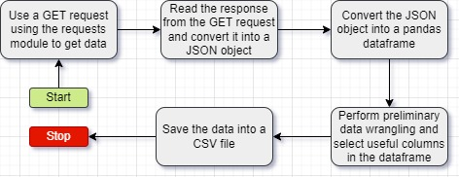
Data Collection – SpaceX API
To collect data, we use the requests module in Python to make API calls to different endpoints at api.spacexdata.com.
The Jupyter notebook for this task can be found at this link.

Slide 9
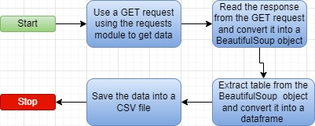
Data Collection - Scraping
To get Falcon 9 data using web scraping, we scraped data from Wikipedia page “List of Falcon 9 and Falcon heavy launches”. Then we extracted data from tables on the page into a CSV file.
The Jupyter notebook for data collection with web scraping can be found at this link.

Slide 10
Data Wrangling
After collecting the data, we performed data wrangling to get basic insights from the data and transform it into a usable format. For this, we performed the following tasks.
Calculate the number of launches on each site.
Calculate the number and occurrence of each orbit
Calculate the number and occurrence of mission outcome of the orbits
Create a landing outcome label from Outcome column for building classification models.
The Jupyter notebook for this task can be found at this link.

Slide 11
EDA with Data Visualization
After data wrangling, we proceeded with data visualization to find answers to our queries on how different factors affect the success of rocket landings.
To visualize the relationship between success rate of each orbit type, we used a bar chart.
To Visualize the relationships between Payload and Orbit type, Flight Number and Orbit type, Flight Number and Launch Site, we used a scatter plot.
To visualize the launch success yearly trend, we used a line chart.
The Jupyter Notebook for this task can be found at this link.

Slide 12
EDA with SQL
After data visualization, we used SQL to gain deeper insights into the data. For this, we used the following queries.
Display the names of the unique launch sites in the space mission
Display 5 records where launch sites begin with the string 'CCA'
Display the total payload mass carried by boosters launched by NASA (CRS)
Display average payload mass carried by booster version F9 v1.1
List the date when the first successful landing outcome in ground pad was achieved.
List the names of the boosters which have success in drone ship and have payload mass greater than 4000 but less than 6000.
List the total number of successful and failure mission outcomes
List the names of the booster versions which have carried the maximum payload mass
List the records which will display the month names, failure landing outcomes in drone ship ,booster versions, launch site for the months in year 2015.
Rank the count of landing outcomes (such as Failure (drone ship) or Success (ground pad)) between the date 2010-06-04 and 2017-03-20, in descending order.
The Jupyter Notebook for the task can be found at this link.

Slide 13
Build an Interactive Map with Folium
To build interactive maps with Folium, I completed the following tasks.
Mark all launch sites on a map.
Mark the success/failed launches for each site on the map.
Calculate the distances between a launch site to its proximities
For this, I used different folium objects such as Map to create the map object, Circle to add a highlighted circle area with a text label on a specific coordinate, Marker to mark a particular coordinate, and MarkerCluster to group multiple markers.
The Jupyter notebook for this activity can be found at this link.

Slide 14
Build a Dashboard with Plotly Dash
To get better insights into the data, I created a dashboard to visualize the success vs failed launches for each SpaceX launch site. It also uses a pie chart to show the total successful launches count for all sites. I have also used a scatter chart to show the correlation between payload and launch success for each site.
The Python file for this activity can be found at this link.

Slide 15
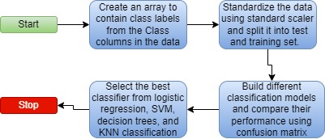
Predictive Analysis (Classification)
To build a classification model, we first created an array to contain class labels. Then, we used standard scaling algorithm to standardize the data. Next, we used different algorithms such as Logistic regression, Support vector machines, decision trees, and K-Nearest Neighbors algorithm to find the best classifier for predicting whether a rocket launch and landing will successful or not based on different factors. The Jupyter notebook for this activity can be found at this link.

Slide 16
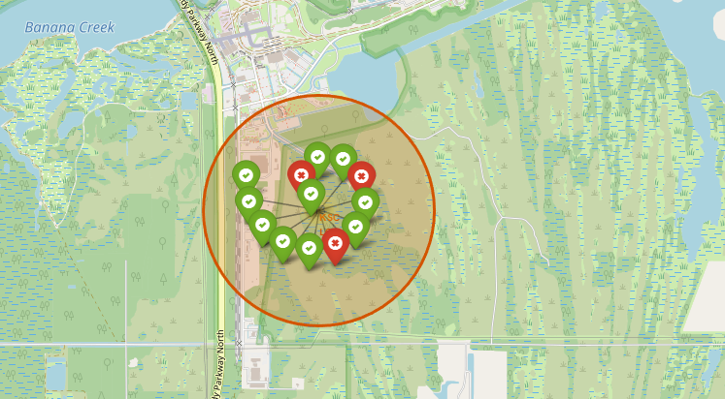
Results
In the next sections, we discuss the outcomes of Exploratory data analysis, Interactive analytics, and Predictive analysis.

Slide 17

Section 2

Slide 18
Flight Number vs. Launch Site
Show a scatter plot of Flight Number vs. Launch Site
Show the screenshot of the scatter plot with explanations

Slide 19
Payload vs. Launch Site
Show a scatter plot of Payload vs. Launch Site
Show the screenshot of the scatter plot with explanations

Slide 20
Success Rate vs. Orbit Type
Show a bar chart for the success rate of each orbit type
Show the screenshot of the scatter plot with explanations

Slide 21
Flight Number vs. Orbit Type
Show a scatter point of Flight number vs. Orbit type
Show the screenshot of the scatter plot with explanations

Slide 22
Payload vs. Orbit Type
Show a scatter point of payload vs. orbit type
Show the screenshot of the scatter plot with explanations

Slide 23
Launch Success Yearly Trend
Show a line chart of yearly average success rate
Show the screenshot of the scatter plot with explanations

Slide 24
All Launch Site Names
Find the names of the unique launch sites
Present your query result with a short explanation here

Slide 25
Launch Site Names Begin with 'CCA'
Find 5 records where launch sites begin with `CCA`
Present your query result with a short explanation here

Slide 26
Total Payload Mass
Calculate the total payload carried by boosters from NASA
Present your query result with a short explanation here

Slide 27
Average Payload Mass by F9 v1.1
Calculate the average payload mass carried by booster version F9 v1.1
Present your query result with a short explanation here

Slide 28
First Successful Ground Landing Date
Find the dates of the first successful landing outcome on ground pad
Present your query result with a short explanation here

Slide 29
Successful Drone Ship Landing with Payload between 4000 and 6000
List the names of boosters which have successfully landed on drone ship and had payload mass greater than 4000 but less than 6000
Present your query result with a short explanation here

Slide 30
Total Number of Successful and Failure Mission Outcomes
Calculate the total number of successful and failure mission outcomes
Present your query result with a short explanation here

Slide 31
Boosters Carried Maximum Payload
List the names of the booster which have carried the maximum payload mass
Present your query result with a short explanation here

Slide 32
2015 Launch Records
List the failed landing_outcomes in drone ship, their booster versions, and launch site names for in year 2015
Present your query result with a short explanation here

Slide 33
Rank Landing Outcomes Between 2010-06-04 and 2017-03-20
Rank the count of landing outcomes (such as Failure (drone ship) or Success (ground pad)) between the date 2010-06-04 and 2017-03-20, in descending order
Present your query result with a short explanation here

Slide 34

Section 3

Slide 35
<Folium Map Screenshot 1>
Replace <Folium map screenshot 1> title with an appropriate title
Explore the generated folium map and make a proper screenshot to include all launch sites’ location markers on a global map
Explain the important elements and findings on the screenshot

Slide 36
<Folium Map Screenshot 2>
Replace <Folium map screenshot 2> title with an appropriate title
Explore the folium map and make a proper screenshot to show the color-labeled launch outcomes on the map
Explain the important elements and findings on the screenshot

Slide 37
<Folium Map Screenshot 3>
Replace <Folium map screenshot 3> title with an appropriate title
Explore the generated folium map and show the screenshot of a selected launch site to its proximities such as railway, highway, coastline, with distance calculated and displayed
Explain the important elements and findings on the screenshot

Slide 38

Section 4

Slide 39
<Dashboard Screenshot 1>
Replace <Dashboard screenshot 1> title with an appropriate title
Show the screenshot of launch success count for all sites, in a piechart
Explain the important elements and findings on the screenshot

Slide 40
<Dashboard Screenshot 2>
Replace <Dashboard screenshot 2> title with an appropriate title
Show the screenshot of the piechart for the launch site with highest launch success ratio
Explain the important elements and findings on the screenshot

Slide 41
<Dashboard Screenshot 3>
Replace <Dashboard screenshot 3> title with an appropriate title
Show screenshots of Payload vs. Launch Outcome scatter plot for all sites, with different payload selected in the range slider
Explain the important elements and findings on the screenshot, such as which payload range or booster version have the largest success rate, etc.

Slide 42

Section 5

Slide 43
Classification Accuracy
Visualize the built model accuracy for all built classification models, in a bar chart
Find which model has the highest classification accuracy

Slide 44
Confusion Matrix
Show the confusion matrix of the best performing model with an explanation

Slide 45
Conclusions
Point 1
Point 2
Point 3
Point 4
…

Slide 46
Appendix
Include any relevant assets like Python code snippets, SQL queries, charts, Notebook outputs, or data sets that you may have created during this project

Slide 47


